Slide 1

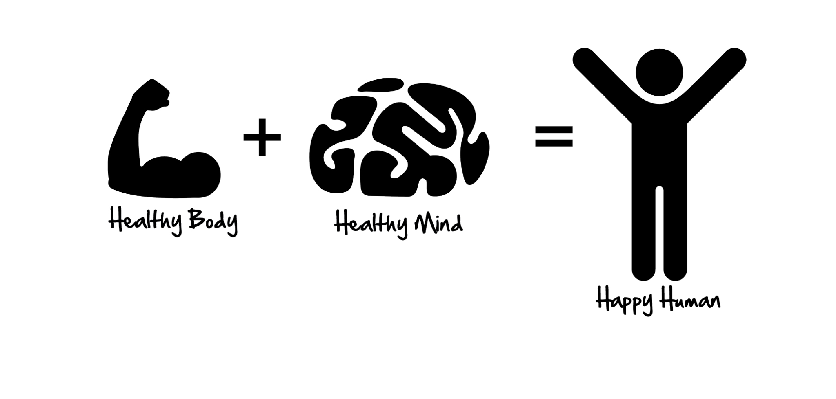

HEALTH IS WEALTH

Slide 2

NSBE Mission
The mission of the National Society of Black Engineers is "to increase the number of culturally responsible Black Engineers who excel academically, succeed professionally and positively impact the community.

Slide 3


ICE BREAKER!!!
Get into the circle and everyone go around and talk about how their health is right now
Everyone go around and introduce themselves; Name, where your from, Major, & Grade.
Why do you think health is very important?
What factors make up your health?
What do you think the most important part of health is?

Slide 4
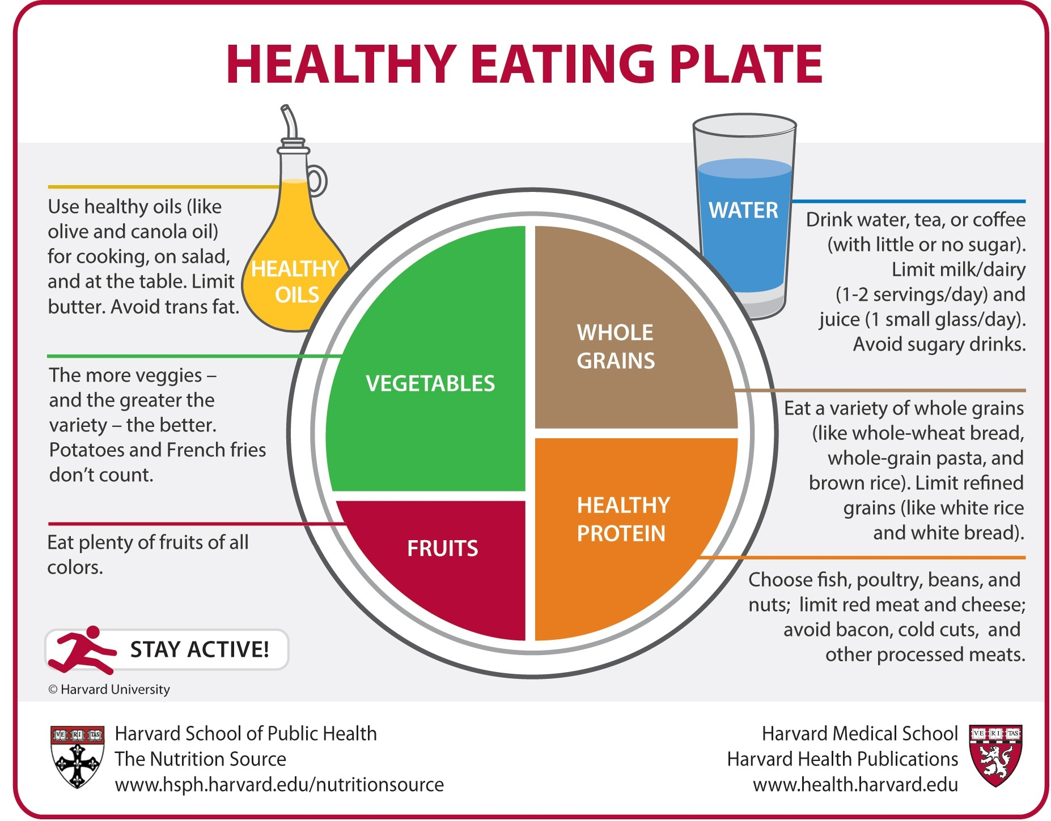
Food/Myplate
A healthy diet is essential for good health and nutrition. It protects you against many chronic noncommunicable diseases, such as heart disease, diabetes and cancer. Eating a variety of foods and consuming less salt, sugars and saturated and industrially-produced trans-fats, are essential for healthy diet.
Notes:
Here is an example of a good myplate for students to eat from

Slide 5
Physical
Regular exercise and physical activity promotes strong muscles and bones. It improves respiratory, cardiovascular health, and overall health. Staying active can also help you maintain a healthy weight, reduce your risk for type 2 diabetes, heart disease, and reduce your risk for some cancers. Here are a few benefits of physical exercise: Weight Management.
Reduce Your Health Risk.
Strengthen Your Bones and Muscles.
Improve Your Ability to do Daily Activities and Prevent Falls.
Increase Your Chances of Living Longer.

Slide 6
Mental Health
Mental health includes our emotional, psychological, and social well-being. It affects how we think, feel, and act. It also helps determine how we handle stress, relate to others, and make healthy choices. Mental health is important at every stage of life, from childhood and adolescence through adulthood.
“The Mind is where all of our thoughts are, in order to have 100 percent control of all our actions we must first control our mind and everything that comes with it.” - Isaac Ojigho

